Slide 1

Welcome to the Riot API Bootcamp!
Know more, win more.

Slide 2








What is the purpose of this course?
Learning to use the Riot API is a bit of a struggle. There's very few resources out there and they're not very structured.
“The Riot API Bootcamp Course is designed to take you from no knowledge up to building your own app.”

Slide 3




Who am i?
Karl, Rocket Scientist & Data Analyst
Past work and collaborations:
Cloud 9
NASA
Wells Fargo
Mozilla
Lockheed Martin
Air Force Research Lab
Siemens, GSK
Experience in everything from AI/ML to jet engine design
“Solve difficult problems with novel methods, by any means necessary”
RebirthNA#2359
@LoL-Genius
417devops@gmail.com

Slide 4
Riot API Bootcamp syllabus
Basics (Python, GitHub, Notepad++)
Resources to get started
Setting up an environment
Downloading GitHub repos
JSON explanation & Notepad++ example
Project: read csv file, convert to data frame, create graphs
Riot API introduction
What is an API?
Getting access & Registering your App
What end points are there/what data is available?
Explanation of puuid/account name
Project: make an API call on the website & download the data
Automating API interactions
Introduction to libraries (Cassiopeia, Riot Watcher)
Getting help (documentation, Discord)
Project: automate an API call using a library
Single Endpoint Data
Use case explanation (e.g., in-depth match analysis, leaderboards)
Code example- getting challenger leaderboard
Project: request last 25 games for an account and determine the most common champion(s)
Large Scale Data Collection
Use case explanation (e.g., match history of top 50 players)
Setting up a process pipeline
Comparing 1 file approach vs. functions across files approach
Project: determine number of roles (TOP, MID, etc) on the challenger ladder using the last 5 games
5 Modules covering core topics Project at the end of each

Slide 5
Module 2: Riot API introduction
Riot API BOOTCAMP
Slide Deck

Slide 6

Module 2: Introductions
Riot API introduction
What is an API?
Getting access & Registering your App
What end points are there/what data is available?
Explanation of puuid/account name
Project: make an API call on the website & download the data
Let’s Dive In

Slide 7
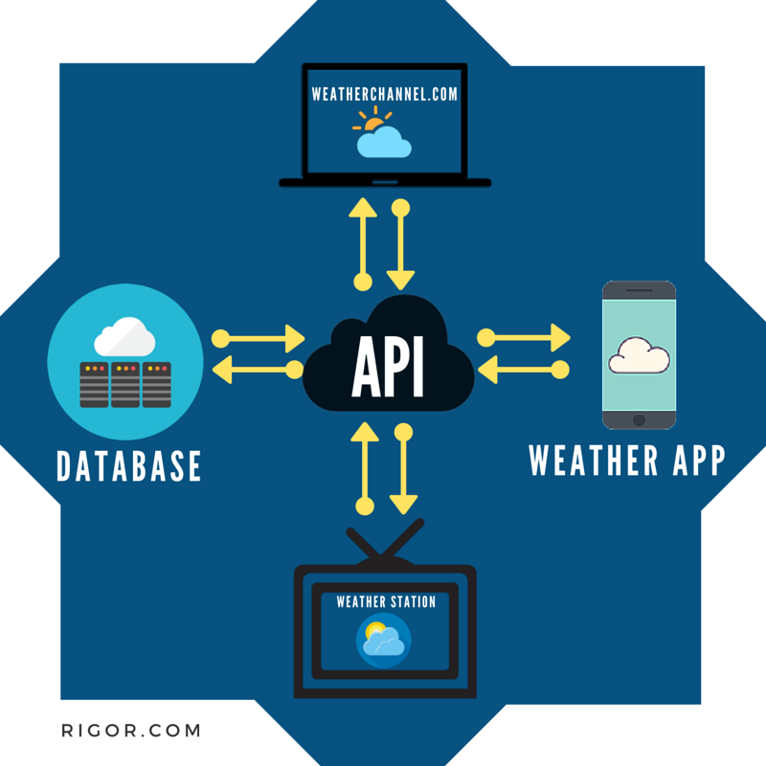
What is an API?
API= Application Programming Interface
Application programming interfaces, or APIs, simplify software development and innovation by enabling applications to exchange data and functionality easily and securely.
An API, enables companies to open up their applications’ data and functionality to external third-party developers, business partners, and internal departments within their companies.
Developers don't need to know how an API is implemented; they simply use the interface to communicate with other products and services.

Slide 8
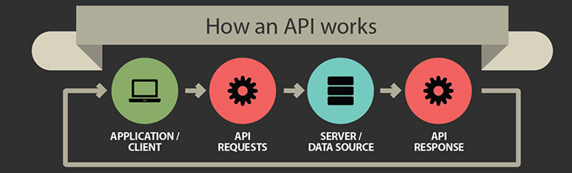
How does an API work?
A client application initiates an API call to retrieve information—also known as a request. This request is processed from an application to the web server via the API’s Uniform Resource Identifier (URI) and includes a request verb, headers, and sometimes, a request body.
After receiving a valid request, the API makes a call to the external program or web server.
The server sends a response to the API with the requested information.
The API transfers the data to the initial requesting application.

Slide 9
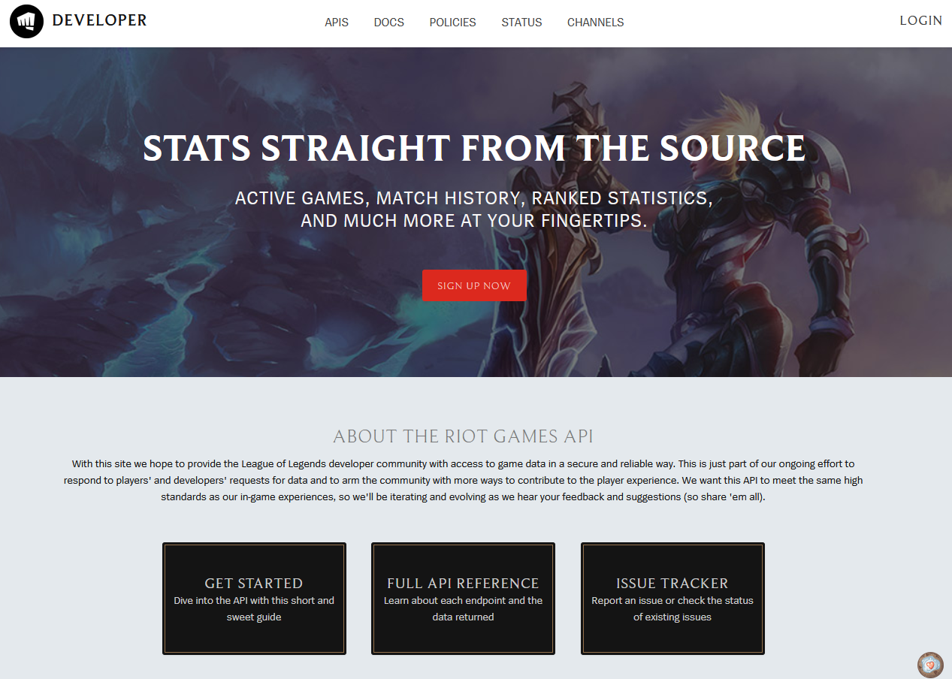
Accessing the Riot API
https://developer.riotgames.com/

Slide 10
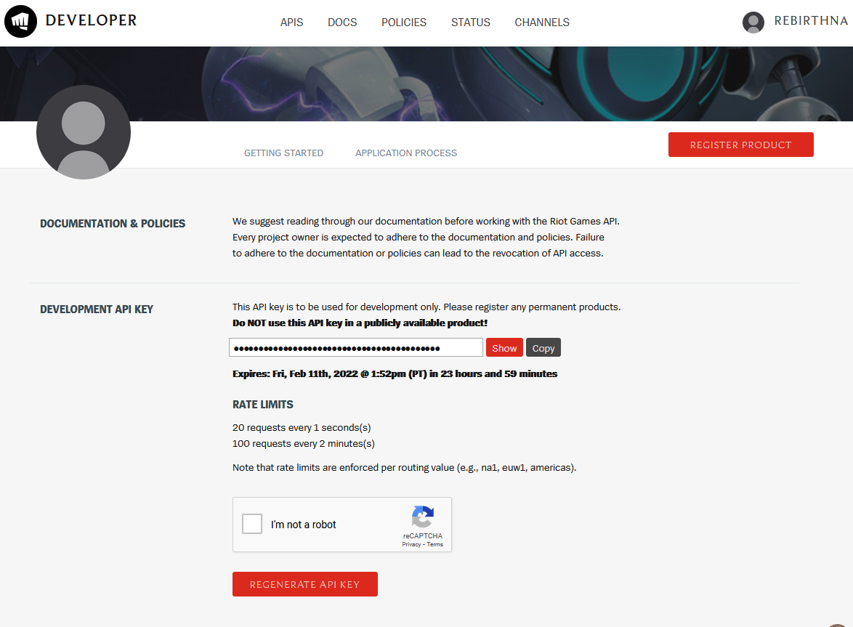
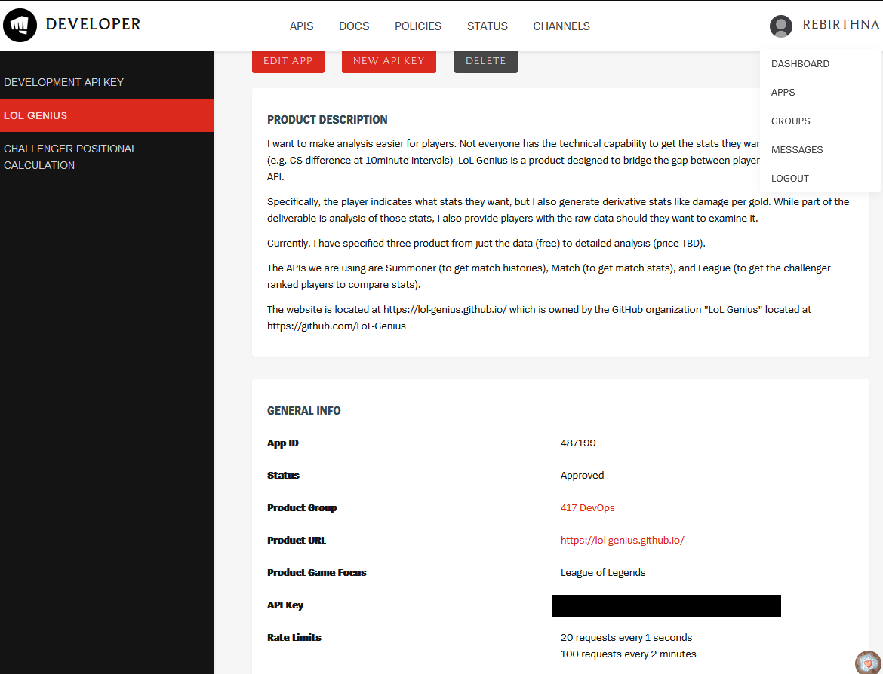
Accessing the Riot API
Every account has a daily developer API key
Registering an app gives you a static API key for that product
DO NOT SHARE YOUR API KEY

Slide 11
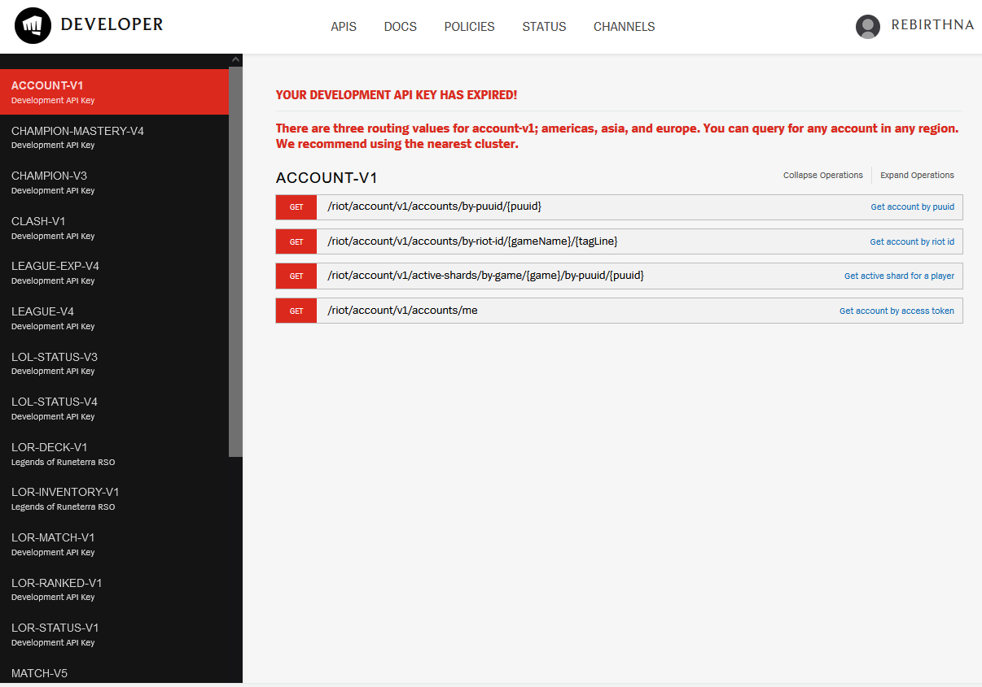
Riot API Endpoints
Each entry on the side is an endpoint
Each endpoint has a different purpose and returns different values
Most commonly used endpoints:
Account-v1
League-v4
Match-v5
Summoner-v4

Slide 12
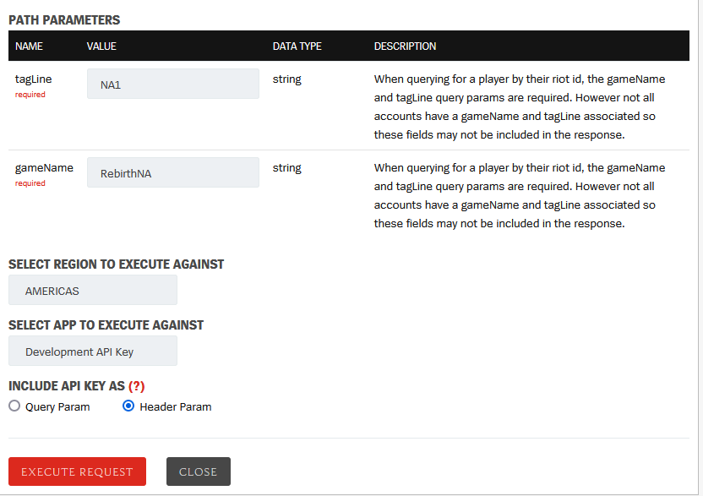
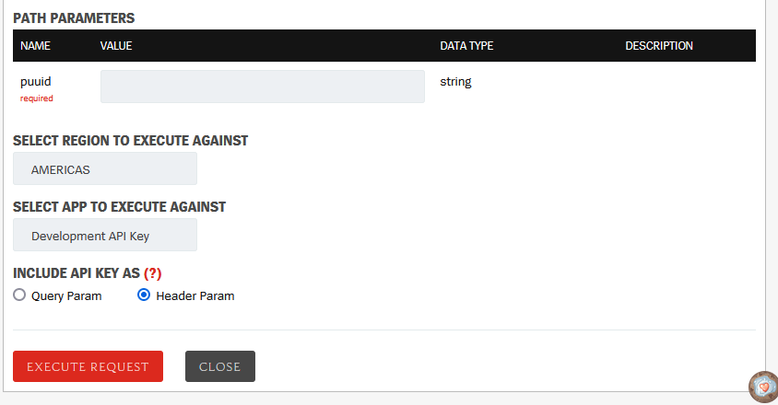
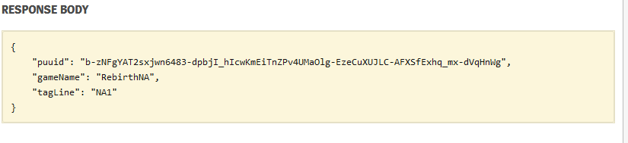
Game Name vs. Puuid
Game name and tagline are what you are used to seeing
puuid (and sometimes accountID) is what Riot uses internally to reference players
You can get one from the other (same API response)
When searching for a player, you will need one of those instead of just their name/tag
gameName/ tagLine endpoint
/riot/account/v1/accounts/by-riot-id/{gameName}/{tagLine}
Puuid endpoint
/riot/account/v1/accounts/by-puuid/{puuid}

Slide 13
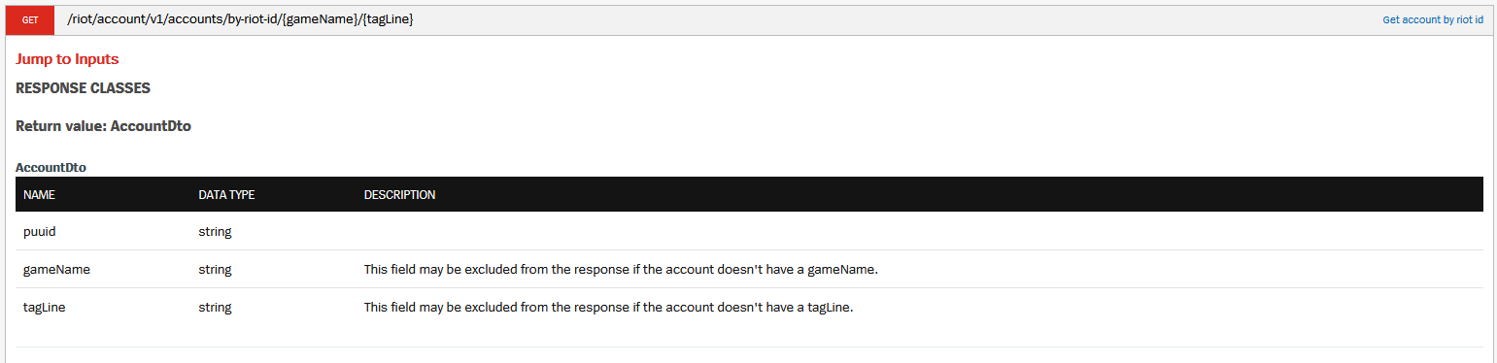
Making A Request on the Website
DEMONSTRATION with
/riot/account/v1/accounts/by-riot-id/{gameName}/{tagLine}

Slide 14

Project-2 Info
Task List:
Make an API call on the website
Download the data
Let’s Dive In

Slide 15


Questions?
Contact me
It is my hope that this course is easy to understand and follow
Have a question or want additional details? Just reach out!
If you want to know more about my work (LoL Genius) or have questions about something you’re building, LMK!

